Slide 1

Bootstrapping pay-as-you-go data integration systems
Literature Report
SIGMOD '08: Proceedings of the 2008 ACM SIGMOD international conference on Management of data June 2008
Zihao Li, 2020.07.19

Slide 2
Problem description
Many application contexts involve multiple data sources (e.g., the web, personal information management, enterprise intranets), how to integrate those data automatically?
Example 1. Consider two source schemas both describing people:
S1(name, hPhone, hAddr, oPhone, oAddr)
S2(name, phone, address)
Clustering the attributes of S1 and S2:
M1({name}, {phone, hP, oP}, {address, hA, oA}) M2({name}, {phone, hP}, {oP}, {address, oA}, {hA}) M3({name}, {phone, hP}, {oP}, {address, hA}, {oA}) M4({name}, {phone, oP}, {hP}, {address, oA}, {hA}) M5({name}, {phone}, {hP}, {oP}, {address}, {hA}, {oA})
Which mediate schema is perfect?

Slide 3
Problem description
Example 2. Consider an instance of S1 with a tuple:
S1: (name, hPhone, hAddr, oPhone, oAddr)
(’Alice’, ’123-4567’, ’123, A Ave.’, ’765-4321’, ’456, B Ave.’)
and a query:
SELECT name, phone, address FROM People
A1: (’Alice’, ’123-4567’, ’123, A Ave.’)
A2: (’Alice’, ’765-4321’, ’456, B Ave.’) A3: (’Alice’, ’765-4321’, ’123, A Ave.’)
A4: (’Alice’, ’123-4567’, ’456, B Ave.’)
Which answer is perfect?

Slide 4
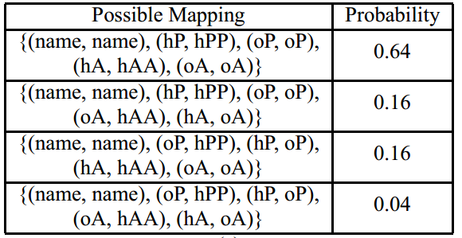
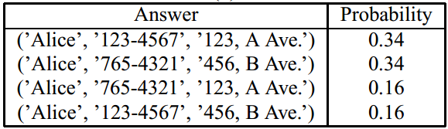
Motivation
Introducing the notion of probabilistic schema mappings which provides a foundation for answering queries in a data integration system with uncertainty about semi-automatically created mappings.
Integration:
Query – Answer:

Slide 5
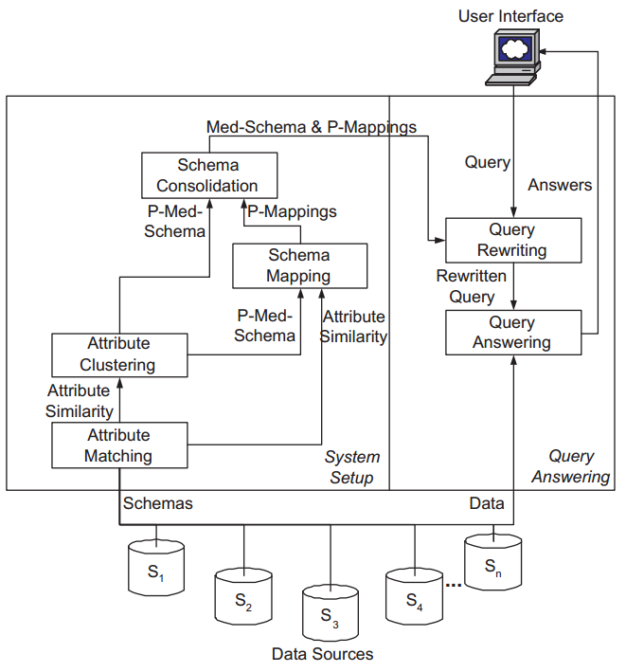
Architecture of our automatic-setup data integration system
Step 1. Construct a probabilistic mediated schema (Preparing the original data source and get the probability distribution).
Step 2. Find best probabilistic schema mappings (Integration based on probability).
Step 3. Create a single mediated schema to expose to the user (Query Answering based on probability)

Slide 6
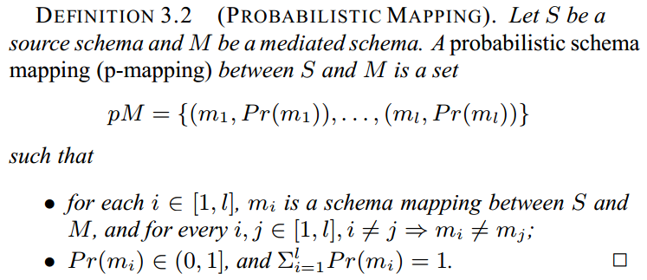
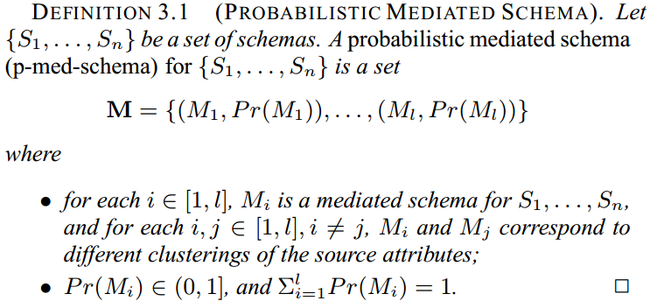
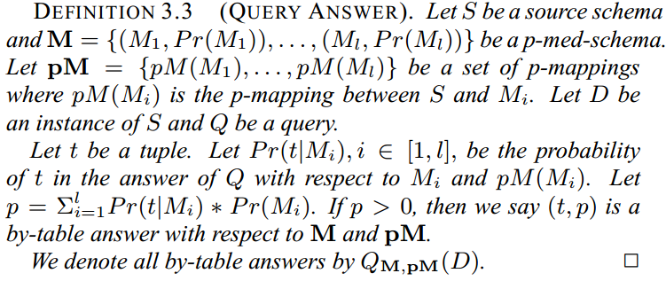
Definition
The distribution of original probabilistic mediated schema from multi-data source
The probability of each mapping schema
Query – Answer pairs based on probability

Slide 7
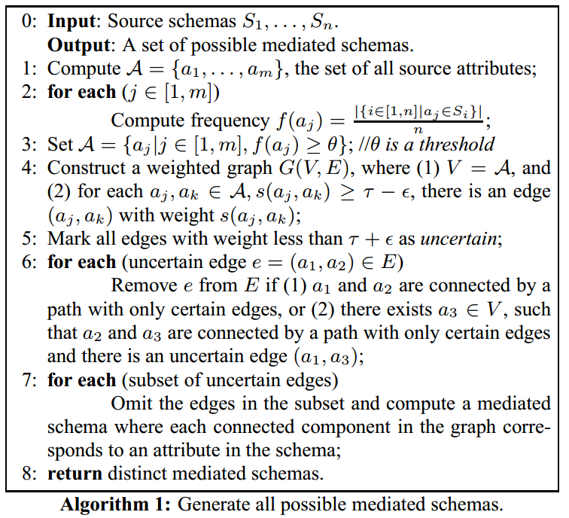
Mediate schema generation – Creating a single mediate schema
Step 1. delete noise data (rare data) based on threshold;
Step2. graph generation. Nodes are attributes and edges are the similarity of connecting notes, isolated notes were deleted (similarity is small than threshold);
Step3. Combine nodes based on uncertain edges;
Nodes similarity: Jaro–Winkler Similarity

Slide 8
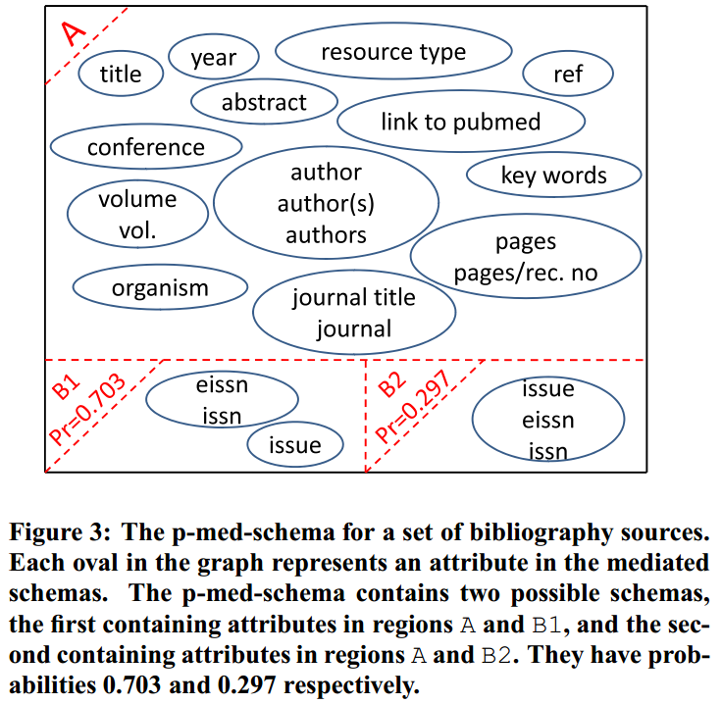
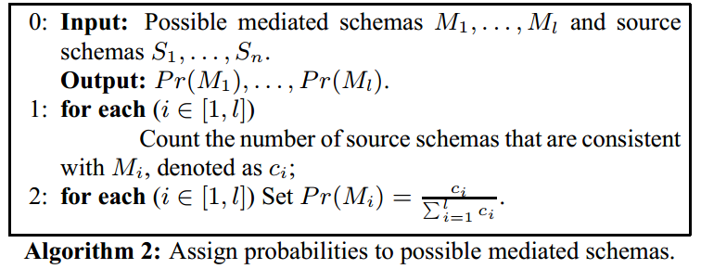
Mediate schema generation – Creating a p-med-schema
The calculation of the probability of mediated schemas (let frequency as probability):

Slide 9
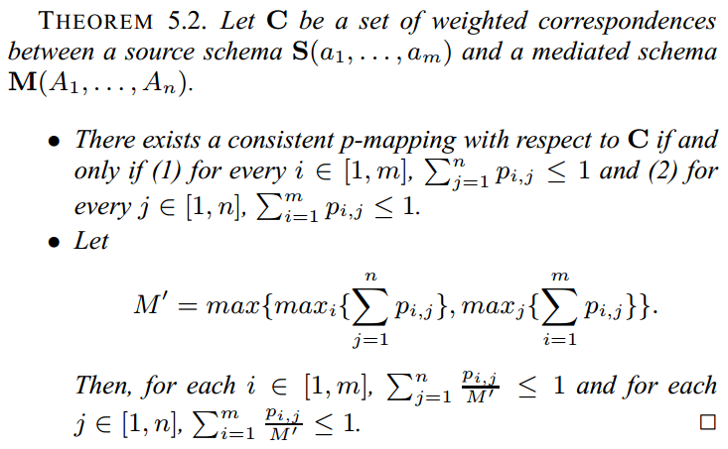
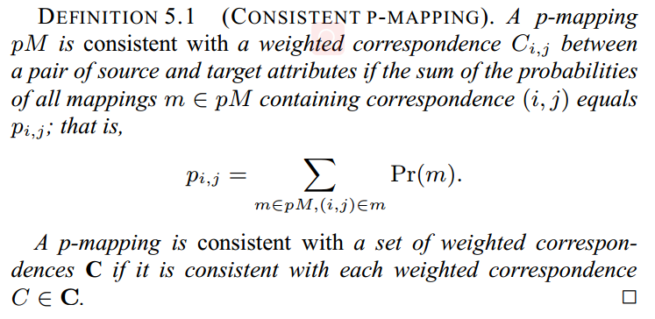
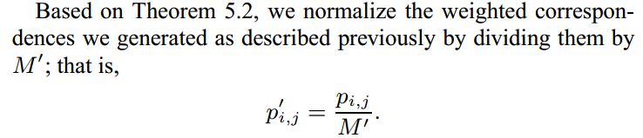
P-mapping generation — computing weighted correspondences
p_(i, j) is the correspondence of source attribute i and the mediated schema attribute j:

Slide 10
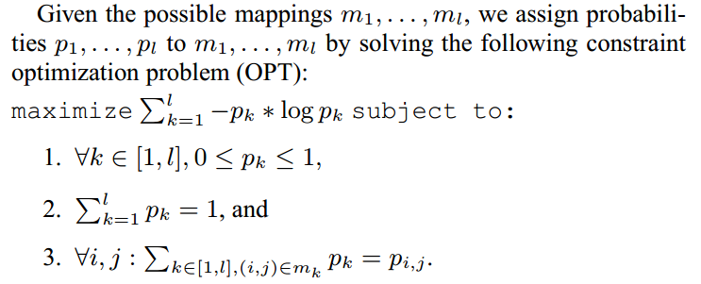
P-mapping generation — Generating p-mappings
Based on the correspondence of each attribute pairwise (i, j), then how to realize the assignment (mapping) of each attribute from source data to intermediate mediate ?
Maximum cross entropy:
Using Knitro (software) to solve the entropy maximization problem in p-mapping construction.

Slide 11
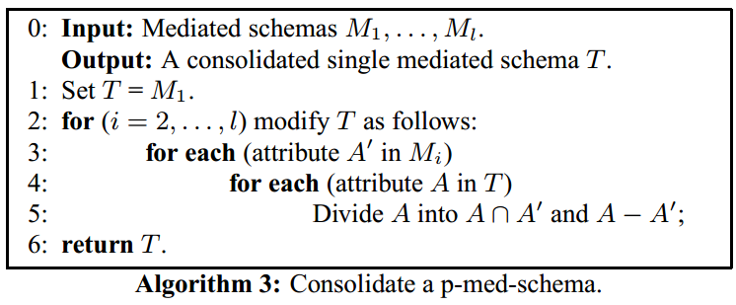
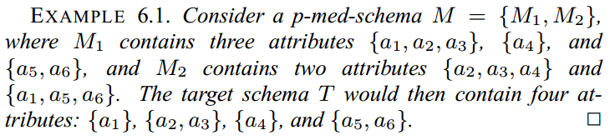
P-mediated-schema consolidation
Combine the multi mediate schema to create a integrated schema T:

Slide 12
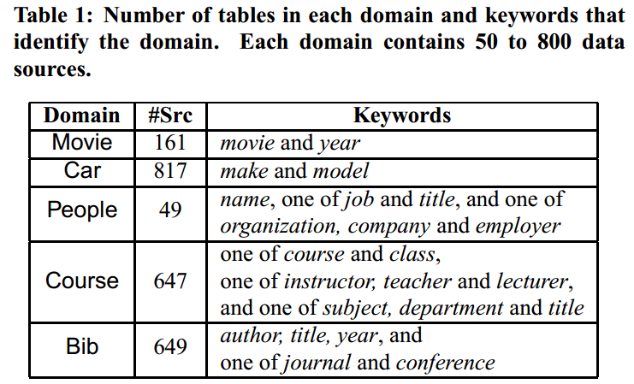
Experiments
Experiment dataset: tables from five domain:

Slide 13
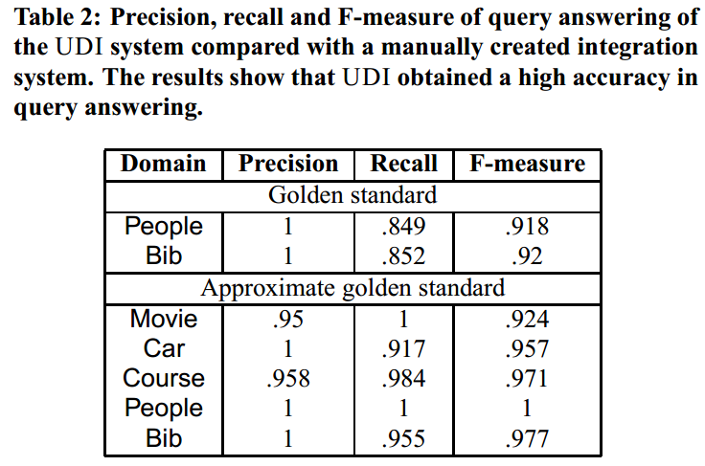
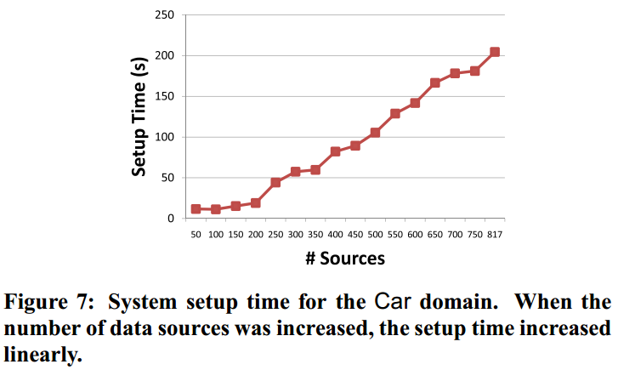
Experiments
Mapping experiment, compared with manual results (golden standard)
The time to set up the system

Slide 14
Conclusion
Automatically set up a data integration application that obtains answers with high precision and recall;
Time should be optimized in the future work;
Human interaction or feedback should be considered in the integration process;

Slide 15
Reference
Das Sarma A, Dong X, Halevy A. Bootstrapping pay-as-you-go data integration systems[C]//Proceedings of the 2008 ACM SIGMOD international conference on Management of data. 2008: 861-874.
Jaro–Winkler distance – Wikipedia. https://en.wikipedia.org/wiki/Jaro%E2%80%93Winkler_distance
Dong X L, Halevy A, Yu C. Data integration with uncertainty[J]. The VLDB Journal, 2009, 18(2): 469-500.
Jeffery S R, Franklin M J, Halevy A Y. Pay-as-you-go user feedback for dataspace systems[C]//Proceedings of the 2008 ACM SIGMOD international conference on Management of data. 2008: 847-860.
Franklin M, Halevy A, Maier D. From databases to dataspaces: a new abstraction for information management[J]. ACM Sigmod Record, 2005, 34(4): 27-33.

Slide 16

Q&A
Reference
Thanks

Slide 17
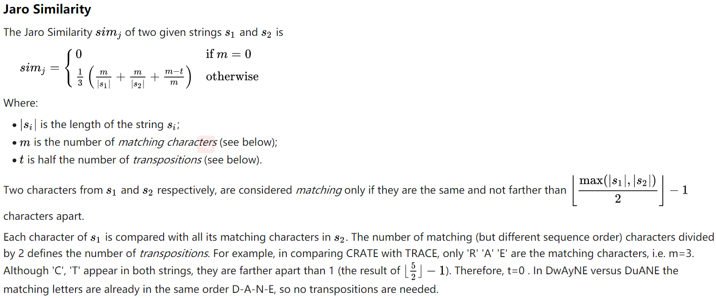
Appendix

Slide 18
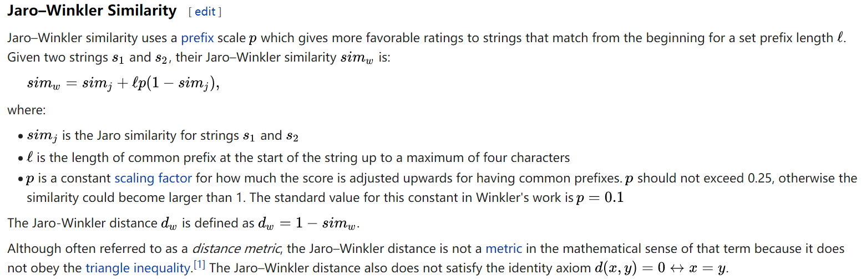
Appendix

